Slide 1
Developing an Information Management Code Repository
Kristin Vanderbilt
Colin Smith
Environmental Data Initiative

Slide 2
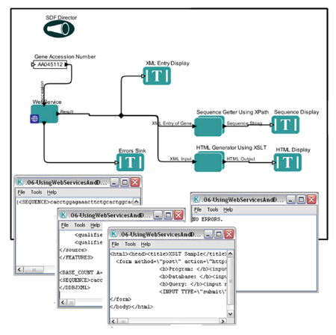




What is the IM code repository?
A community space where participants contribute code and discover code to re-use
For Information Managers, scientists, students, others
Limited to code for IM tasks
Language agnostic

Slide 3

Our goal today…
…is to create a blueprint for how the IM code repository will operate

Slide 4

Considerations:
Repository
Structure
Governance
Code
Minimum requirements
Discoverability
Other considerations?

Slide 5
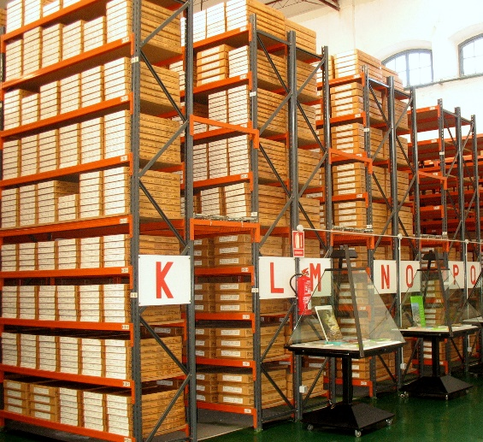
How should the IM Code Repository be structured?
Decentralized approach – the repository is essentially a catalog, pointing to whatever repository the code developer prefers
Centralized approach – all code is in one repository and managed by one group
Hybrid approach – the centralized repository with a catalog

Slide 6
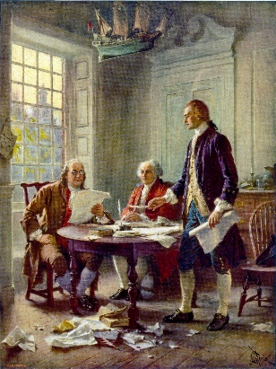
How should the code repository be governed?
A committee:
Composed of IMs and code developers
Responsible for:
ensuring that code passes quality tests
evaluating metadata for quality and completeness
Distributed workload
Issues:
Number of members
Term of service
Credit for service

Slide 7

What are the minimum requirements for software to be included?
Generalized, not project specific
Well documented:
At the package level – using metadata (e.g. codemeta project), installation instructions, example use (e.g. vignette)
At the script level – commented and consistent with language best practices
Version controlled – so users are aware of changes
Road map – defining intended scope of the code
Error messages – provides meaningful feedback
Passes tests:
does the code do what it says it does
what methods do the authors use to test the code

Slide 8

What mechanisms will be employed to ensure that code is discoverable?
A controlled vocabulary for code metadata and repository tags
An an application to query the metadata of software in the repository. E.g.:
Creator
Description
Encoding
Funder
Keywords
License
Programming language
Software help
Software requirements
Readme
Etc.

Slide 9


Other considerations
Incentives to contribute to repository
Maintenance/updates of code
User support by code creator?
Licensing
Citation/DOI

Slide 10

Join us to finish the IM Repository blueprint!
Volunteers sought to co-author or review the ‘blueprint’

